Slide 1
Flower Classification using Deep Learning
Intern Thira-Scheitzner Eduard-Paul
Mentor Szakacs Laszlo

Slide 2

What is Deep Learning?
Deep Learning is a way of teaching a machine what comes naturally to us humans. The primary way in which a machine learns is through a myriad of examples. This technology is the basis of self-driven cars and image classification software. In Machine learning, there is no need for millions of samples to learn to distinguish between a stop sign and a person. On the other hand, Deep Learning software requires many examples in order to be properly trained.

Slide 3
Image Classification
Is a part of Machine Learning in which we teach the computer to classify certain images with labels based on what a human would do

Slide 4
The Dataset
In this project, I trained my model to distinguish and separate flowers into 5 classes (Tulip, Sunflower Lilly, Orchid and Lotus). In the following slides, I will go in-depth about my dataset.

Slide 5
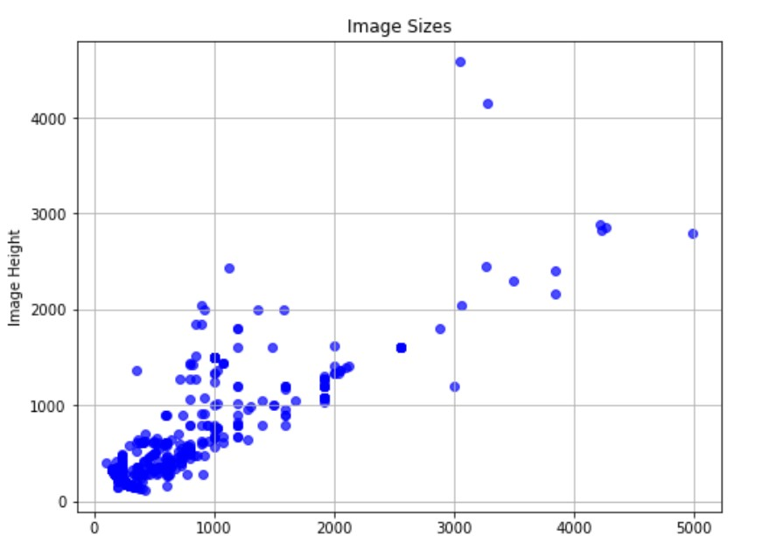
Dataset 1

Slide 6
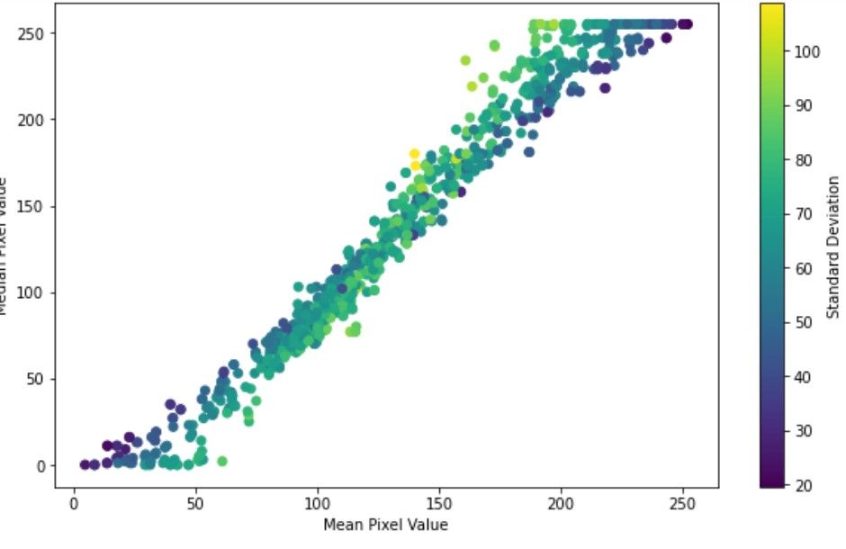
Dataset 2

Slide 7
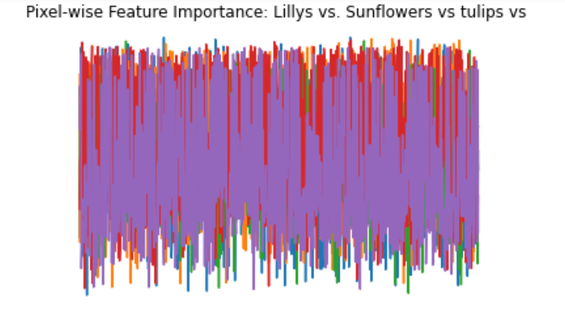
Dataset 8

Slide 8
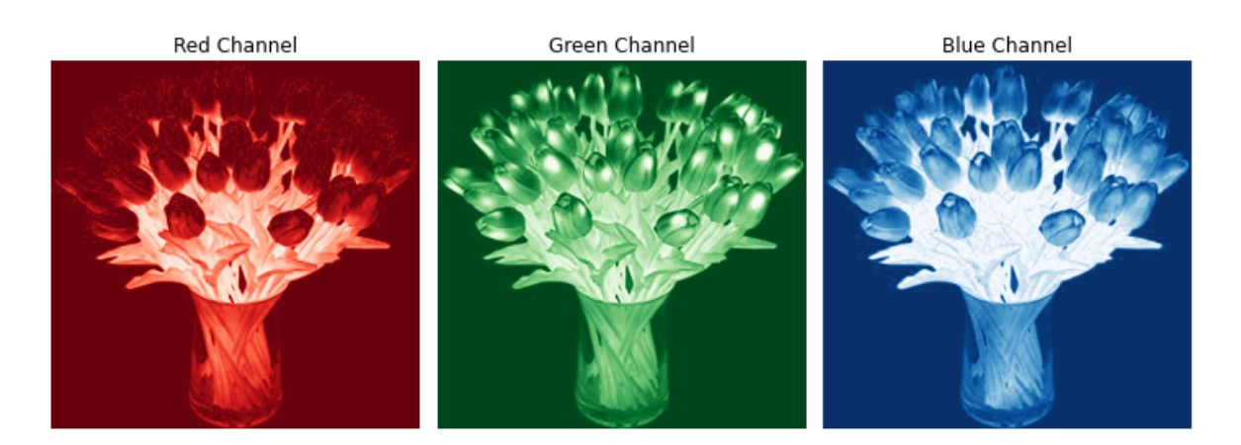
Dataset 3

Slide 9
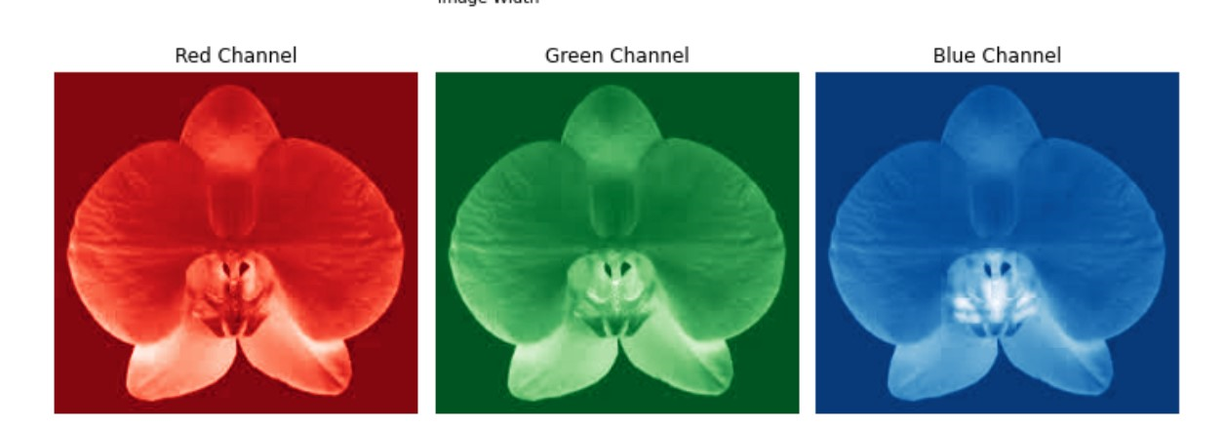
Dataset 4

Slide 10
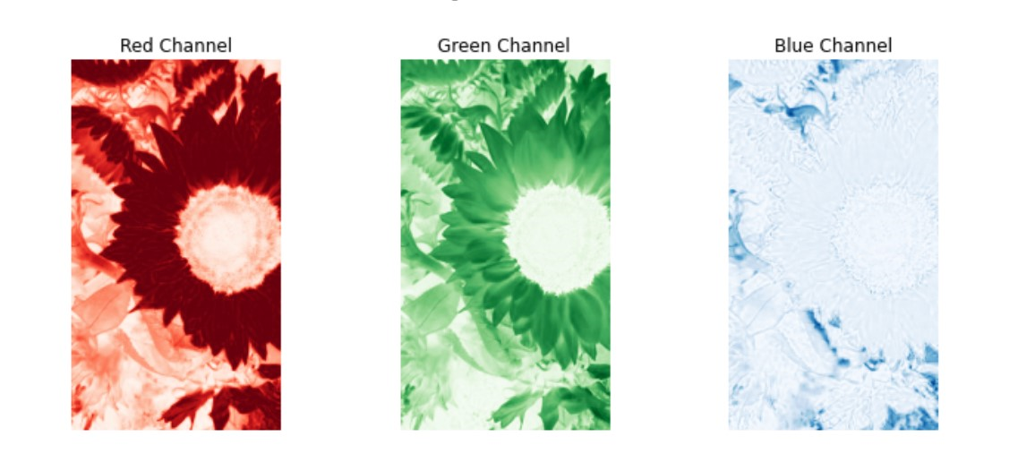
Dataset 5

Slide 11
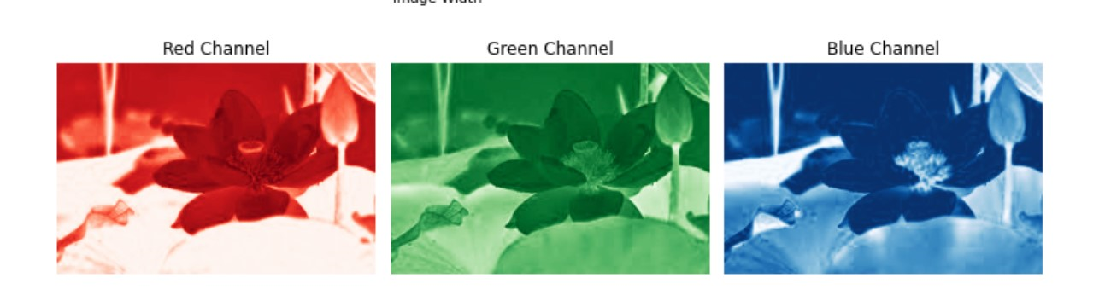
Dataset 6

Slide 12
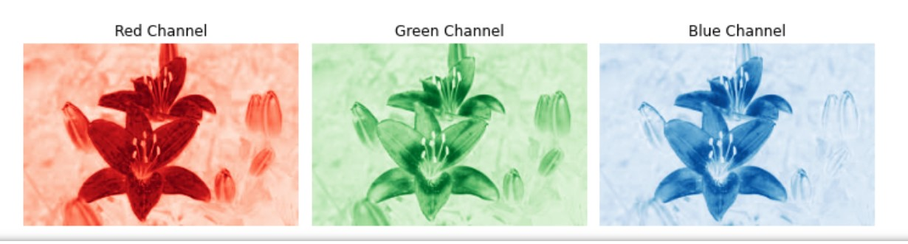
Dataset 7

Slide 13
The Network
In the following slides I will present the network used in my project

Slide 14
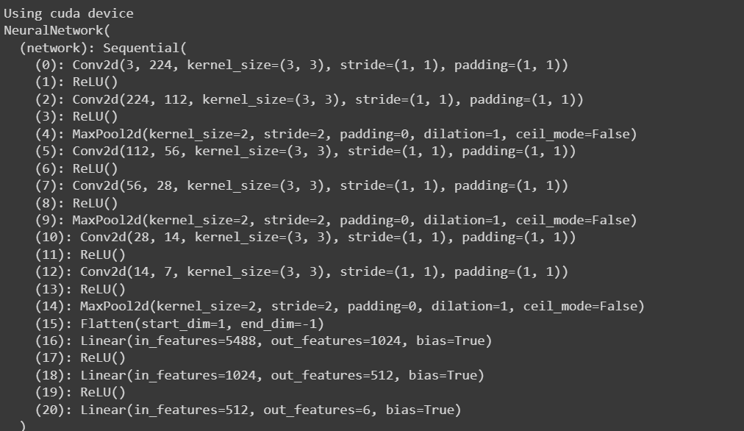
Network 1

Slide 15
Experiments and Results

Slide 16
Experiments
In this project, there were countless experiments that have been done.
I have tried subtracting 2 layers and adding a bigger stride to certain convolutional layers but there were no positive changes
I have also tried changing the optimizer for the model which has drastically improved the performance of our model.
Another significant change was the relabeling of the data which was faulty at best

Slide 17
Results
After a training period of 30 epochs, the model achieved an accuracy of 87.5% on the training set.
Unfortunately I could not run the accuracy on the dev and the test set

Slide 18
Challenges
Along the way of this project, there were some hiccups that must have been overcome

Slide 19
Challenges
The main challenges of this project were:
The mislabeling of the dataset
Not using the proper optimize
The poor time management on my part

Slide 20
Conclusions

Slide 21
Conclusions
Although the accuracy was quite low and the loss was extremely high I do think that the project could be improved in the future by:
Using a bigger dataset
Training it for longer periods of time
Building a deeper more complex CNN

